Slide 1
Structure discovery by Transformer networks

Slide 2
Very Short history … deep learning
MultiLayer Perceptron: since 1958, Rosenblatt. Since 2009: theory behind training deep models (Bengio, et al.)
RNN (recurrent neural networks): (1925, Ising), 1980, various people
Backpropagation: 1982, Werbos a.o.
LSTM (long-short term memory): 1995, Hochreiter et al.
Word2vec: 2013, Mikolov, Google team
Sequence to sequence: 2014, Sutskever et al. (now at OpenAI)
Transformers: 2017, Vaswani et al.
BERT (Bidirectional Encoder Representations from Transformers), 2018, Google (and many variants)
Audio, s2t: Wav2vec2.0, 2020: Whisper, 2022 (and variants)

Slide 3
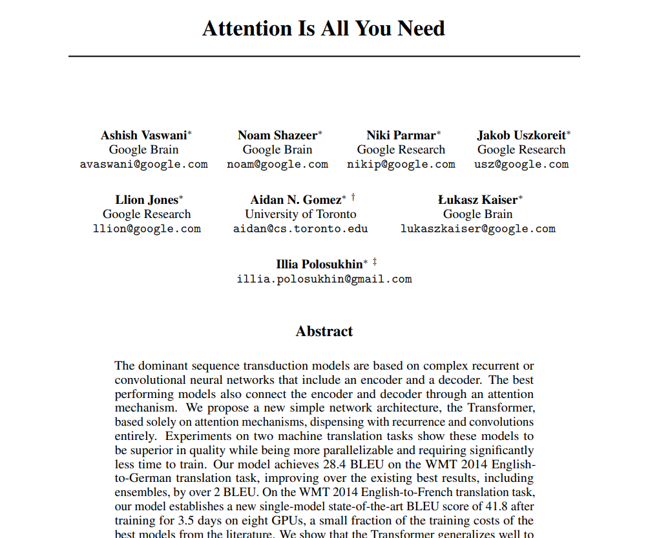
One of the KEY papers (2017)

Slide 4
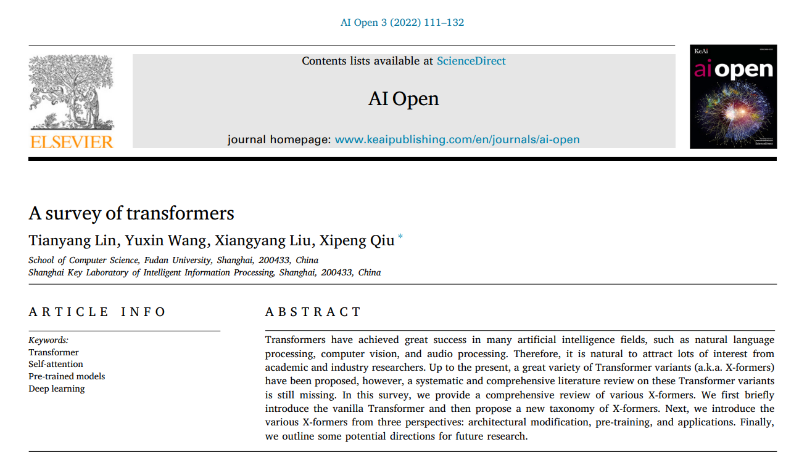
another KEY paper (2022)

Slide 5
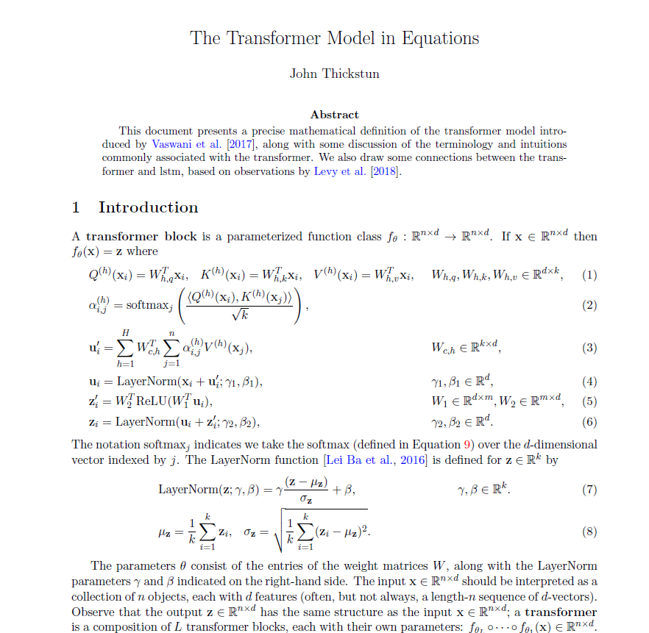

Slide 6
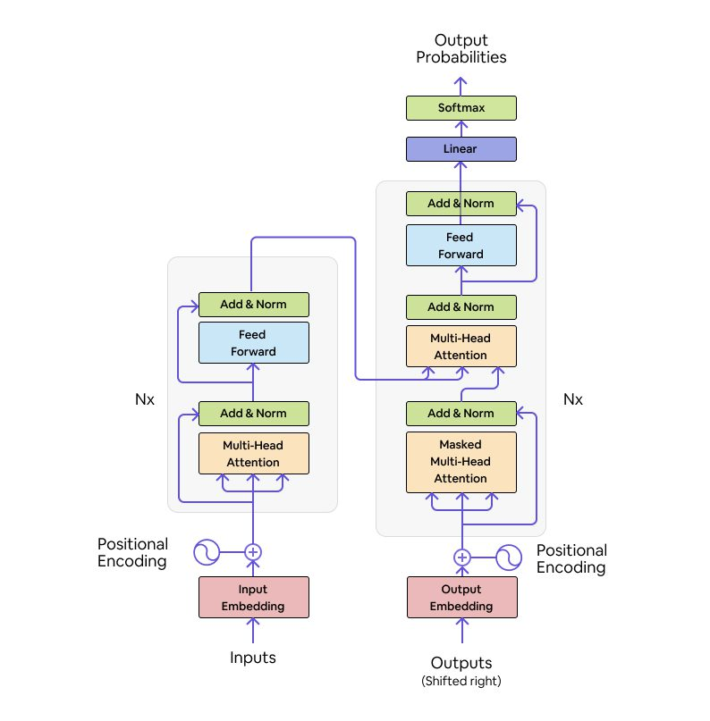
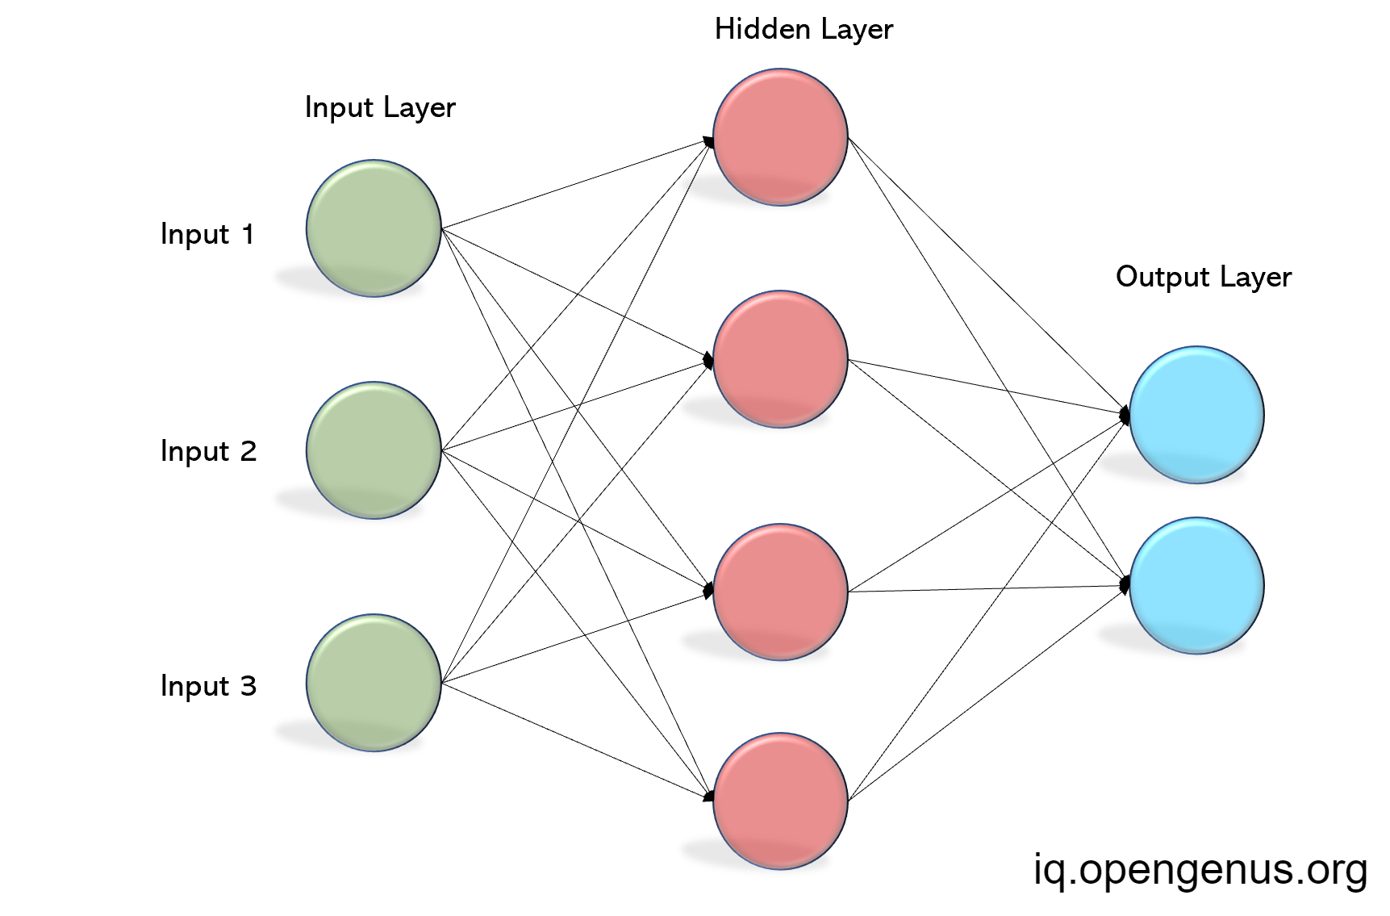
NETWORKS
(From the Attention paper)

Slide 7
Vectors and networks
Vector sequences
Tokens sequences
(words, graphemes, phonemes) + activations
Networks
(of any kind)
Word sequences
Or audio
Vector sequences

Slide 8
SFMs and LLMs – see e.g. Verdini et al. (2025)
Vector sequences
Embedding in LLM vector space
LLM
SFM
Text prompt
Audio
Vector sequences
Pre-context
(“co-text”)
Next token prediction
+ activation (p())

Slide 9
HOW DO WE GET THESE VECTORS?
Large text -> word2vec -> vectors (one vector per word)
  One per orthographic form, context-indep.
  Context-dependent, e.g. homophones (Eng.) bank – bank
  (not the scope of this course)
Audio -> feature extraction -> vectors
  “Spectral slices”
  Typically one vector per 10 ms or 20 ms

Slide 10
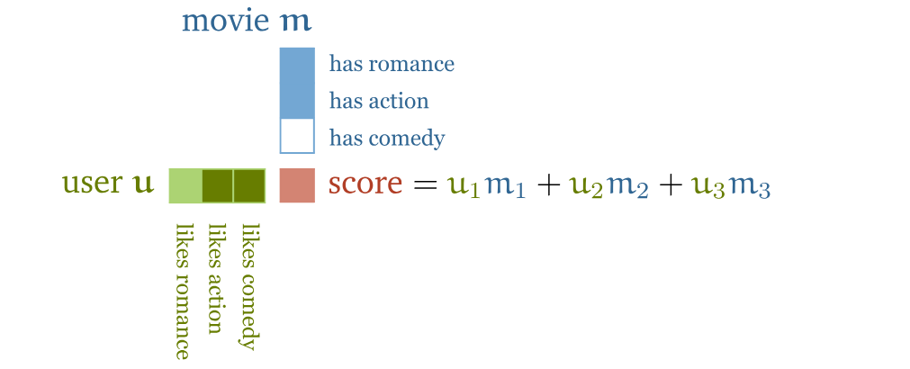
Understanding why self-attention works, in particular the dotprot construction
See https://peterbloem.nl/blog/transformers

Slide 11
Understanding why self-attention works, in particular the dotprot construction
See https://peterbloem.nl/blog/transformers
“provide”
“ask”

Slide 12
Understanding why self-attention works, in particular the dotprot consTruction
See https://peterbloem.nl/blog/transformers
“provide” key
=u^{t}m
“ask” query

Slide 13
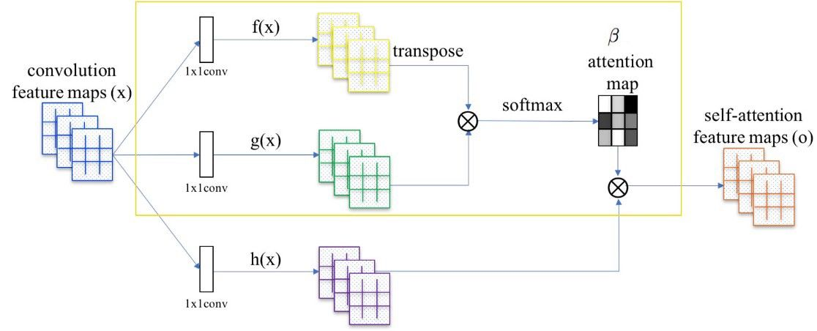
In practice, attention is a bit more complex

Slide 14
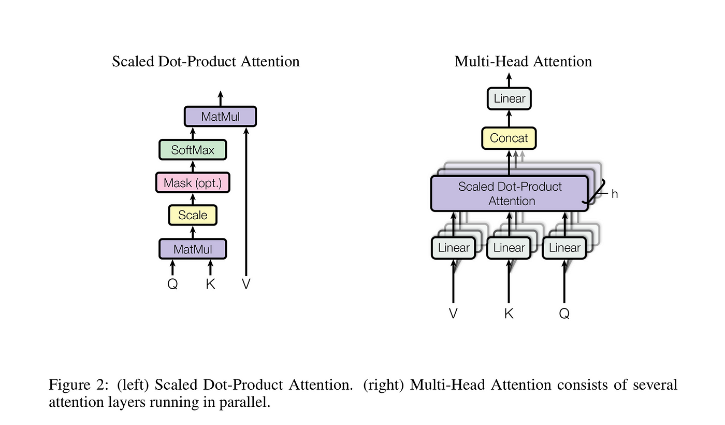
Attention paper

Slide 15
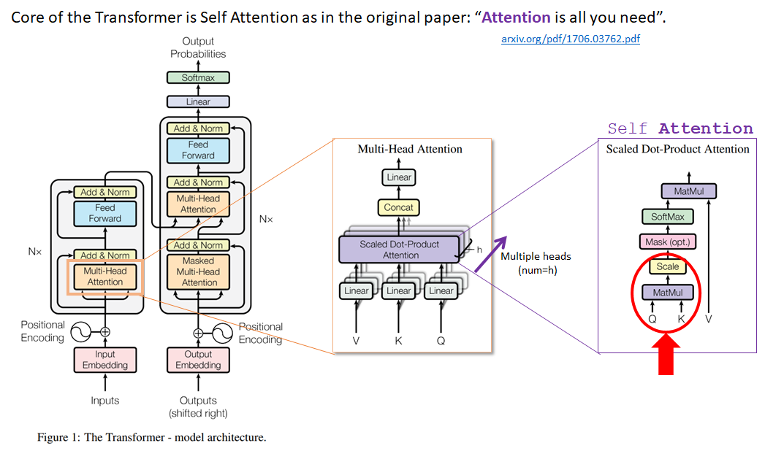

Slide 16
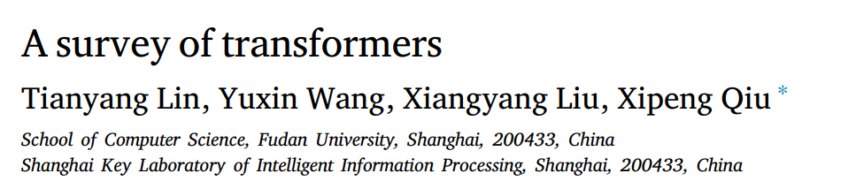
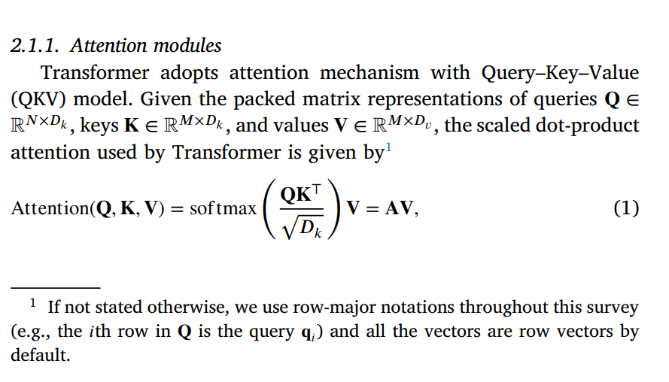
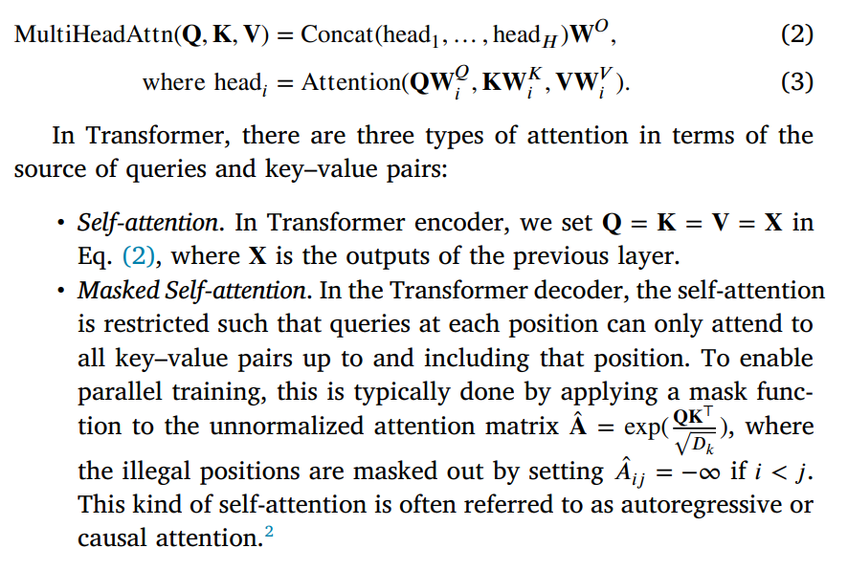

Slide 17
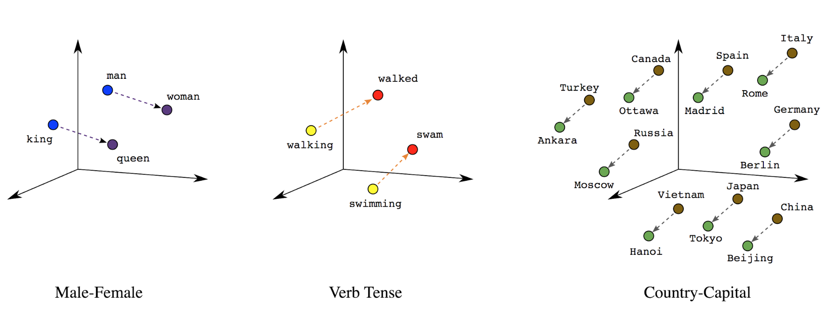
Words as vectors (word EMBEDDINGs)
Dimension??
100, 300 (word2vec)
768 (BERT, …)
1024 (Wav2vec2.0)

Slide 18
Intro
We use Transformers every day
Transformer-based models are topic of investigation in multiple research directions, such as
Explainability (interpretabilty – goes further)
Approximation theory
Linguistics

Slide 19
Intro
Explainability
  addressing the question to what extent decisions by Deep Neural Networks (DNNs) can be ’explained’ and understood.
  The ’classical’ techniques (probing, feature attribution, integrated gradients, LIME, SHAP) appear often less useful than hoped in Transformer-based models
  Mechanistic Interpretability is a novel and expanding group of techniques (’computational lenses’) with the goal to understand which decisions are made in the network, to aid formal verification and human interpretability.

Slide 20
LIME and SHAP
LIME Local Interpretable Model-agnostic Explanations
approximates the model locally with a simpler model to explain predictions.
fast, approximate, local, ignorant
SHAP SHapley Addictive exPlanations
fairly distributes credit for a prediction among features using game theory (shapley features)
more mathematically grounded, consistent, but computationally more expensive

Slide 21
LIME and SHAP
LIME (Local Interpretable Model-Agnostic Explanations)
Idea: Approximating the model locally with a simpler, interpretable model (like linear regression).
perturb (tweaks) the input data, check how the predictions change, fit a simple model
the coefficients of this simple model tell which features contribute most
SHAP (SHapley Additive exPlanations)
Idea: Explain predictions using game theory, treating features like “players” in a cooperative game.
It calculates Shapley values, which come from cooperative game theory, ensuring a fair distribution of contribution
Contributions are calculated by considering all possible combinations of features

Slide 22
Intro
Approximation theory
  mathematical underpinning of so-called ’limited width/depth networks’.
  a classical result says that (under specific conditions) feedforward networks with sufficient width and depth are general approximators.
  Approximation theorems say what neural networks can learn in terms of mappings
Current speech encoder/decoder architectures can learn highly complex mappings from the audio feature space to the word embedding space, due to stacked non-linear layers and weighted context dependency.

Slide 23
Intro
Linguistics
  In formal linguistics, sentences obey a particular structure: as a linear sequence of phrases, or of nested phrases
  Formally, grammatical complexity can be organized along a scale inspired by the Chomsky hierarchy (Finite, Regular, Context-Free, mildly Context-Sensitive, Context Sensitive, ...).
In spoken language, and certainly in spontaneous speech, the structure of utterances may deviate substantially from the formal properties of sentences in written text, but spoken utterances are not random and still obey a grammatical structure

Slide 24
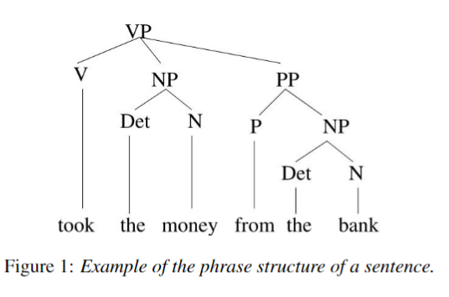
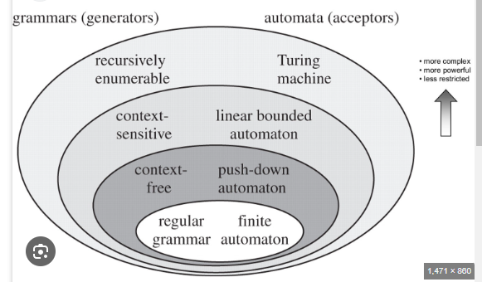

Slide 25
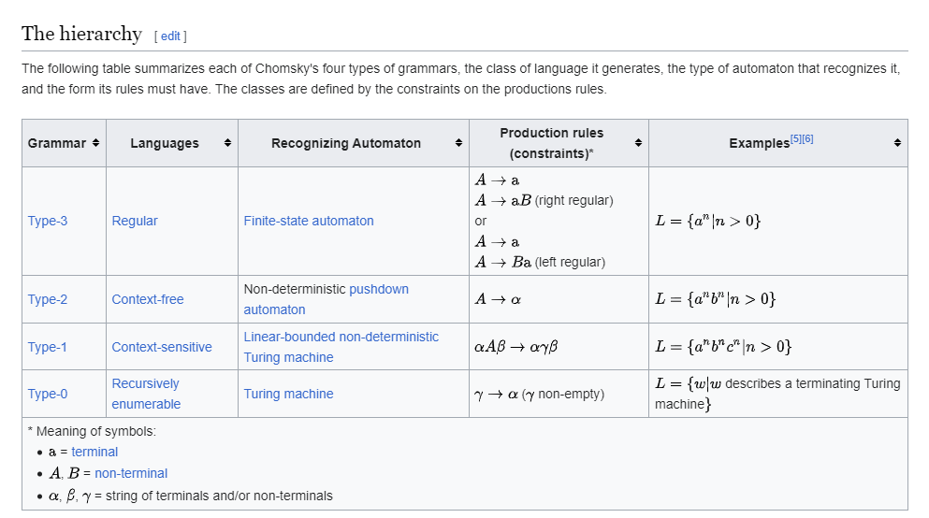

Slide 26
Transformers are powerful
leeuw olifant slang leeuw muis aap aap kat leeuw aap
leeuw slang slang slang kat leeuw olifant leeuw hond slang
aap hond kanarie leeuw slang slang olifant hond leeuw slang
kat leeuw hond kat olifant kanarie olifant leeuw kanarie slang
hond aap leeuw kanarie hond olifant leeuw kanarie kanarie hond
slang slang leeuw olifant muis leeuw muis kanarie kanarie kat
leeuw hond slang leeuw olifant aap aap slang leeuw aap
leeuw muis kat olifant kat kat aap leeuw slang kat
aap leeuw olifant kat hond hond muis slang hond leeuw
muis muis aap leeuw aap slang olifant leeuw kat leeuw
hond leeuw olifant olifant leeuw kat kanarie aap hond aap
kat leeuw hond hond kanarie kat kanarie kat olifant leeuw
hond muis aap slang leeuw kanarie olifant slang leeuw muis
hond aap slang olifant slang slang leeuw leeuw kat muis
kat kat aap kat kanarie muis muis aap olifant leeuw
aap olifant kanarie aap leeuw kat muis kat hond kanarie
kat aap kat kat olifant hond hond aap muis hond
slang kanarie slang kanarie aap leeuw aap kanarie leeuw aap
hond muis muis olifant kanarie olifant slang leeuw kanarie slang
slang kat muis muis slang slang muis leeuw slang slang
leeuw aap hond hond leeuw kanarie hond slang hond olifant
muis leeuw aap hond kanarie kanarie kanarie aap kat slang
olifant muis muis leeuw kanarie olifant kanarie kat leeuw slang
hond kat muis aap leeuw leeuw leeuw kat kanarie leeuw
hond slang aap slang muis slang leeuw kat slang olifant
muis muis leeuw leeuw leeuw aap kanarie aap hond kanarie
+ -

